Slide 1






Introduction to Predictive Modeling
Learning-by-doing
Case Study Retail Propensity
AEP HIDAYATULOH
Head of Data Analytics
StarCore Analytics
https://github.com/aephidayatuloh/propensity
aephidayatuloh

Slide 2

Requirement
R (>= v4.2.0) and
RStudio installed
(Latest version recommended)
01
Required Tools and Packages
Install {tidyverse}, {tidymodels}, {rpart},
{DALEX}, {DALExtra}
02
Download data/code from github repository
03

Slide 3

Our Learning
Agenda
Introduction to Predictive Model and Propensity
Introduction to Logistic Regression
Model Assessment Metrics
Hands-on

Slide 4
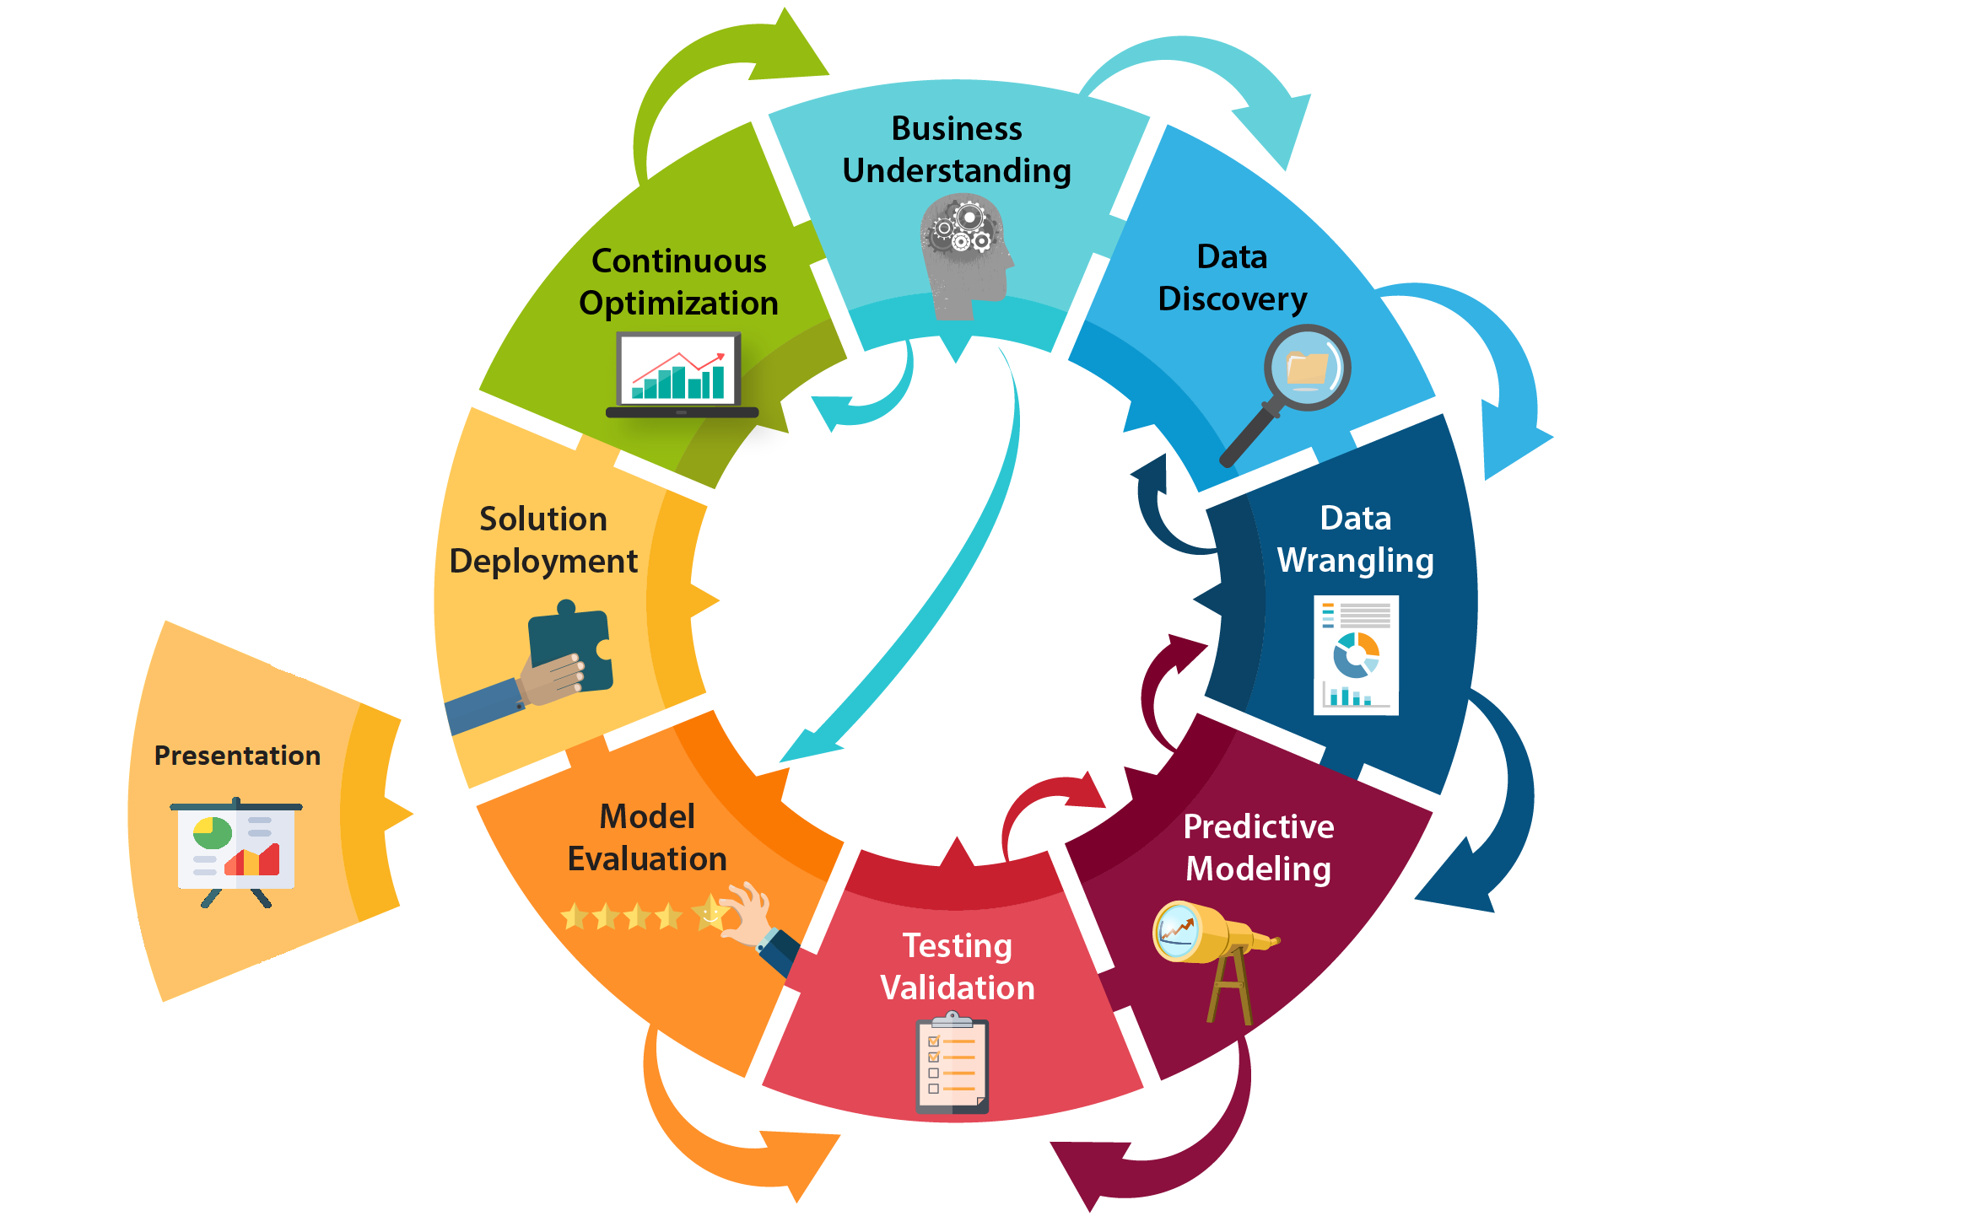
Data Science Flow

Slide 5

Fundamental of Statistical Model & Machine Learning
Build Predictive Model

Slide 6

Predictive Model
Do you know?
Statistical & Machine Learning Model is used to predict the unknown events
Built based on historical data (both transactional and operational data)
In the business world it is often used to estimate risks and business opportunities, based on certain characteristics or attributes
What you want to predict (target variable) can be :
numeric variable
(e.g. price, profit, exchange rate, etc.)
categorical/class variable
(e.g. risk level, willingness to buy, success, type, etc.)

Slide 7



Usage Example
01
02
03
Credit Scoring - Approval
Residence Pricing Strategy
Disease Detection
Estimating whether a credit applicant is included in the group of applicants who will later pay off (good) or not (bad).
Variable: demography, socio-economic, credit history owned.
The target variable is categorical
(Classification)
Estimating the appropriate house price to offer to prospective buyers.
Variable: building characteristics, facilities (bed, bathroom, garage), location, supporting infrastructure around the house (toll roads, malls/markets, hospitals, sports, etc).
The target variable is numeric
(Regression)
Detect the level of infection of a disease in individuals
Variable: lifestyle (food, smoking, alcohol consumption, etc.), parental medical history, environmental conditions where you live.
The target variable is categorical
(Classification)

Slide 8
Component of Predictive Modeling
• Target Variable
Variable to be predicted, often called the response variable or dependent variable.
Frequently used notation: Y.
• Input Variable
Variable that will be used to predict, often also called the explanatory variable (predictor variable) or the independent variable.
Frequently used notation: X
• Functional Model
Mathematical/computational function that relates the value of X to the value of Y. Statistical models that are widely used include:
Linear Regression
Logistic Regression
Decision Tree
Random Forest

Slide 9

Propensity
Propensity : an often intense natural inclination or preference, tendency (Merriam Webster Dictionary)
Offering Promo or Campaign
Probability that someone is interested in accepting the offer

Slide 10

“All models are wrong, but some are useful”
George Edward Pelham Box (George Box)

Slide 11




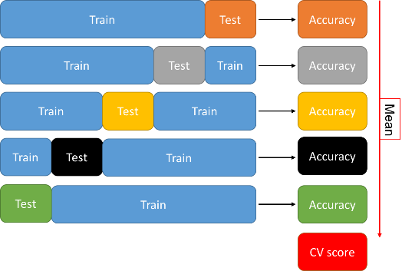

Stages of Building Model
Build Model
Testing
Training
Evaluation
Cross Validation
Deploy Model

Slide 12
Numeric Target
Categoric Target
=> Regression <=
=> Classification <=
Linear Regression
Polynomial Regression
Regression Tree*
Random Forest
Support Vector Regression
Gradient Boosting
eXtreme Gradient Boosting
Extremely Randomized Trees
Neural Network
etc.
Binary Logistic Regression
Classification Tree*
Random Forest
Naïve Bayes
Support Vector Machine
Gradient Boosting
eXtreme Gradient Boosting
Extremely Randomized Trees
Neural Network
etc.
*Decision Tree

Slide 13
Types of Logistic Regression
Types of Logistic Regression
by Response Variable
Two Categories
Binary
Yes
No
Three or More Categories

Slide 14
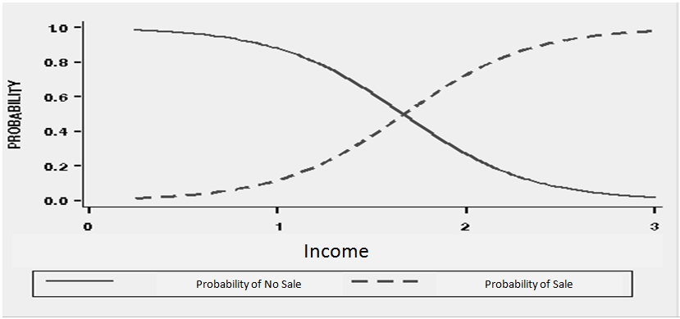
Logistic Regression
Y
Logistic Regression Curves
₁
₀
Predictor

Slide 15

Logistic Regression
Probability
Logistic Regression Curves

Slide 16
Assumption
P_{i}
Logit(P_{i})
Logit Transform
Predictor
Predictor

Slide 17
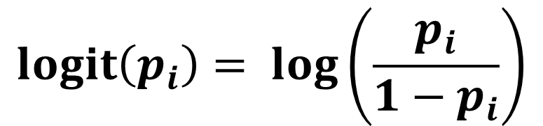
Logit Transformation
Logistic Regression models transformed probabilities called logit.
where
i indexes all cases (observations).
p_{i} is the probability the event (a sale, for example) occurs in the i^{th} case.
log is the natural log (to the base e).
$$logit\left(p_{i}\right)= \log\left(\frac{p_{i}}{1−p_{i}}\right)$$
Suppose p is the probability value of occurrence of a certain category. In the model, the value of p is P(customer interested in the offer), P(default customer), P(affected by the disease), and so on.
The p/(1 – p) value is ratio between the probability of something that will be happen to the chance that it will not happen, called ODD.
Logit transformation is natural logarithm of the odd.

Slide 18
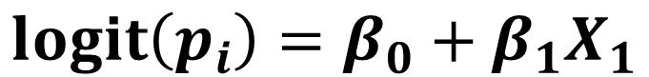
Logistic Regression Model
$$logit\left(p_{i}\right)=β_{0}+β_{1}X_{1}$$
where
logit(p_{i}) logit transformation of the probability of the event
β₀ intercept of the regression line
β₁ slope of the regression line.
Logistic Regression model use Iteratively Reweighted Least Squares (IRLS) and Maximum Likelihood (ML) method to calculate b₀ and b₁.

Slide 19
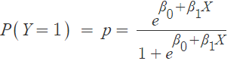
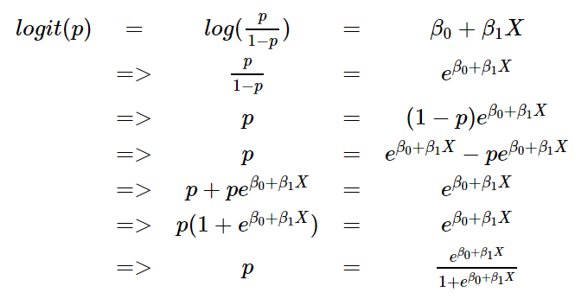
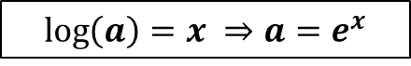
Logistic Regression Model
$$\log\left(a\right)=x ⇒a=e^{x}$$

Slide 20
Logistic Regression Model

Slide 21
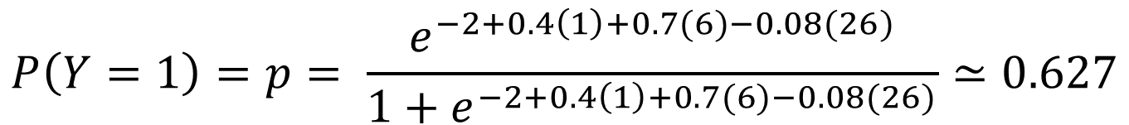
Logistic Regression Model
$$P\left(Y=1\right)=p= \frac{e^{−2+0.4∗\left(Gender=Male\right)+0.7∗Income−0.08∗Age}}{1+e^{−2+0.4∗\left(Gender=Male\right)+0.7∗Income−0.08∗Age}}$$
$$P\left(Y=1\right)=p= \frac{e^{−2+0.4\left(1\right)+0.7(6)−0.08(26)}}{1+e^{−2+0.4\left(1\right)+0.7(6)−0.08(26)}}≃0.627$$
ID | Gender | Income | Age | P(Response)
1 | M | 6 | 26 | 0.627
2 | M | 8 | 28 | 0.853
3 | F | 7.5 | 50 | 0.321

Slide 22
Predicted Class with Cut-off Probability
Actual Class
Probability
Predicted Class
Case
x
response
P
cut-off=.5
cut-off=.25
1 75.8 0 .32 0 1
2 68.3 1 .40 0 1
3 14.1 1 .92 1 1
4 99.2 0 .06 0 0
5 65.4 1 .52 1 1
6 68.7 1 .39 0 1
7 76.7 1 .22 0 0
8 81.5 0 .17 0 0
9 82.4 0 .13 0 0
. . . . . .
. . . . . .
. . . . . .
n 45.5 1 .75 1 1

Slide 23
Model Performance Metrics
Positive = Interesting event => response = 1
Predicted Class
1
0
True Positive
False Negative
Accuracy = (TP + TN) / #N
Sensitivity/Recall = TP/Total Actual Positive
Specificity = TN/Total Actual Negative
Precision = TP/Total Predicted Positive
F1 Score = 2*TP/(2*TP+FP+FN)
= (2*Precision*Recall)/(Precision+Recall)
1
Actual Class
False Positive
True Negative
0
The desired proportion is high

Slide 24
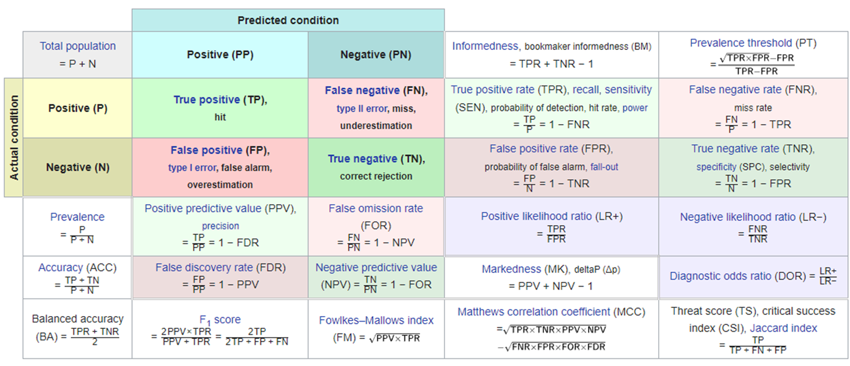
Model Performance Metrics

Slide 25
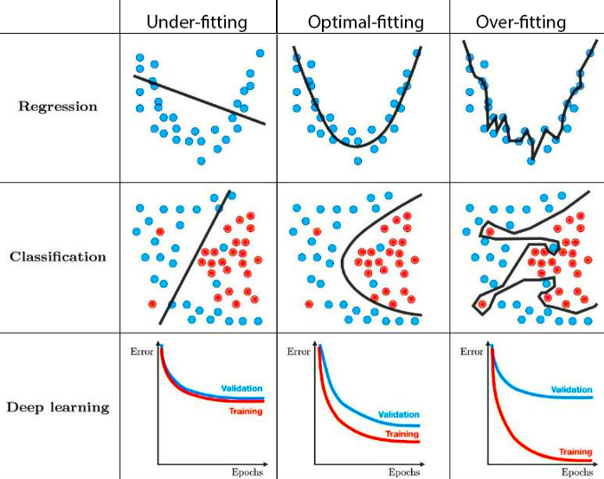
Under-fit & Over-fit
Jangan hanya menggunakan poin butir.
Karena perhatian audiens lebih mudah teralihkan saat online, presenter perlu menggunakan cara berbeda.
Visualisasikan informasi yang rumit dengan grafik dan bagan. Ini adalah alat bantu visual yang membantu menambahkan konteks ke dalam topik Anda.

Slide 26

Business and Data
Retail has done pilot campaign to 4,970 members.
A retail company has conducted a campaign for its members by looking at demographic variables and aggregate transactions from the previous 3 months.
Assume transaction data is obtained from October, November and December. The Campaign Period is during January of the following year.
In early February, results were obtained from members who responded and who did not.

Slide 27

Variable | Description
member_id | member's ID
gender | gender of member
visit_last_1mo | number of visits within month 1 (December)
visit_last_2mo | number of visits within month 2 (November)
visit_last_3mo | number of visits within month 3 (October)
spending_last_1mo | spending amount within month 1 (December)
spending_last_2mo | spending amount within month 2 (November)
spending_last_3mo | spending amount within month 3 (October)
age | age of members
monthly_income | member's monthly income
marital_status | marital status of members
payment_channel | most frequent channel used
groceries | dummy variable whether member buy groceries product in last 3 months (1: buy; 0: no)
toiletries | dummy variable whether member buy toiletries product in last 3 months (1: buy; 0: no)
food | dummy variable whether member buy food product in last 3 months (1: buy; 0: no)
electronic | dummy variable whether member buy electronic product in last 3 months (1: buy; 0: no)
clothes | dummy variable whether member buy clothes product in last 3 months (1: buy; 0: no)
home_appliances | dummy variable whether member buy home appliances product in last 3 months (1: buy; 0: no)
others | dummy variable if member bought other than product above
recency_last_visit | number of days member last visit (recency)
response | dummy variable whether member taken the promo or not on the end of January (1: yes; 0: no)

Slide 28
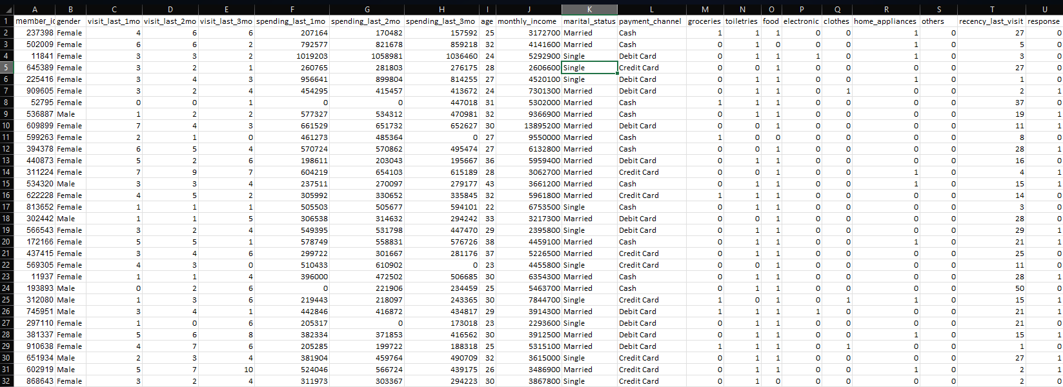


Data Preview

Slide 29
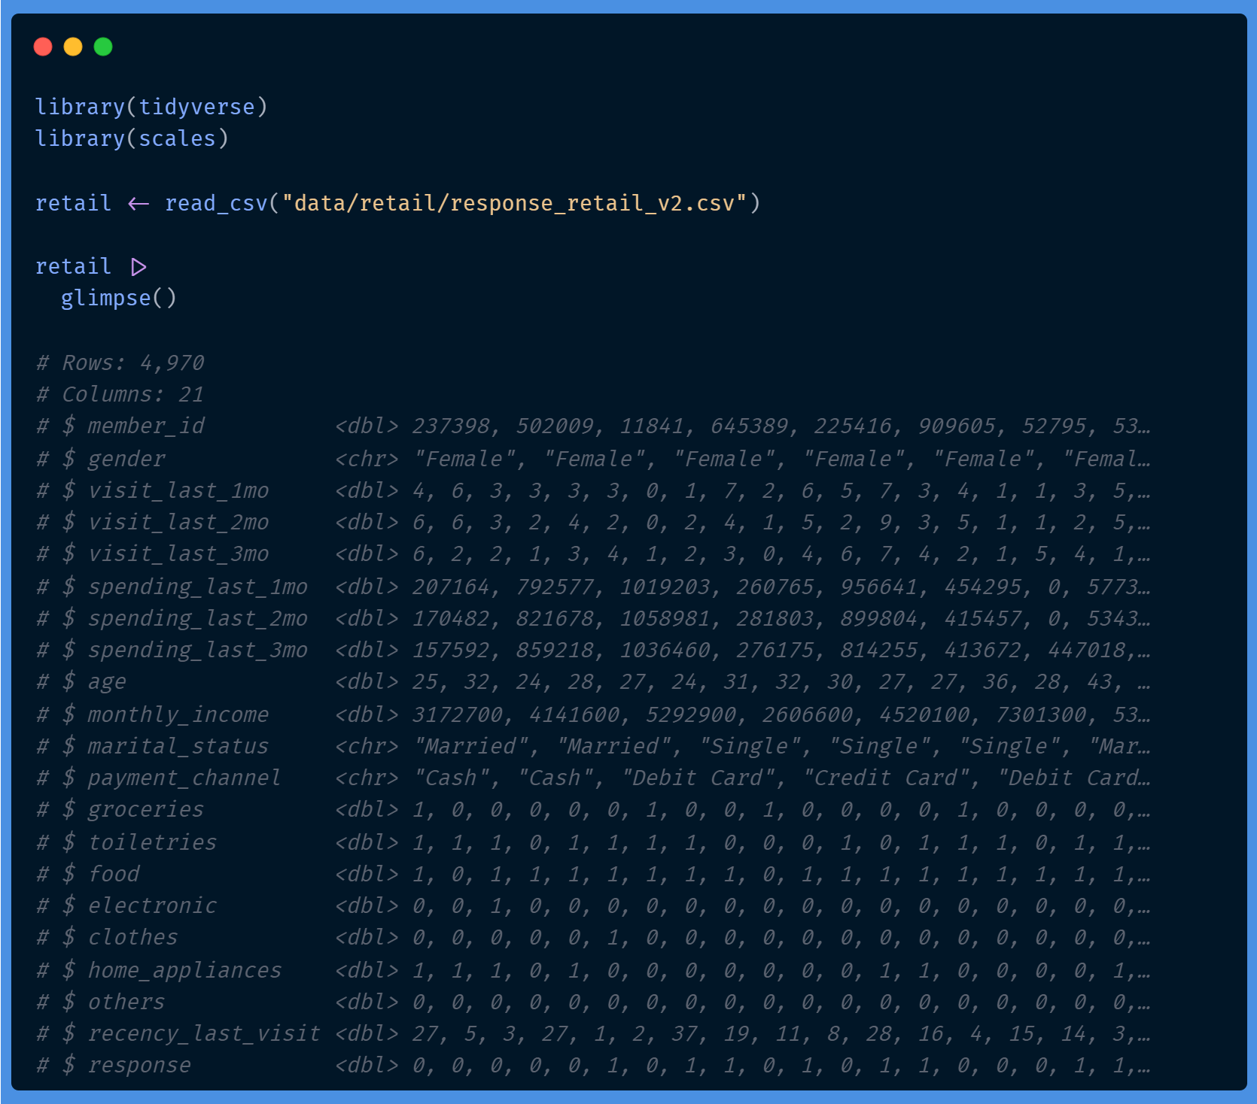
Variable | Type
member_id | ID
gender | Factor/category (binary)
visit_last_1mo | Number
visit_last_2mo | Number
visit_last_3mo | Number
spending_last_1mo | Number
spending_last_2mo | Number
spending_last_3mo | Number
age | Number
monthly_income | Number
marital_status | Factor/category
payment_channel | Factor/category
groceries | Factor/category (binary)
toiletries | Factor/category (binary)
food | Factor/category (binary)
electronic | Factor/category (binary)
clothes | Factor/category (binary)
home_appliances | Factor/category (binary)
others | Factor/category (binary)
recency_last_visit | Number
response | Factor/category (binary target)
Import & Data Preparation

Slide 30

Data Quality Exploration
Getting to know your data

Slide 31
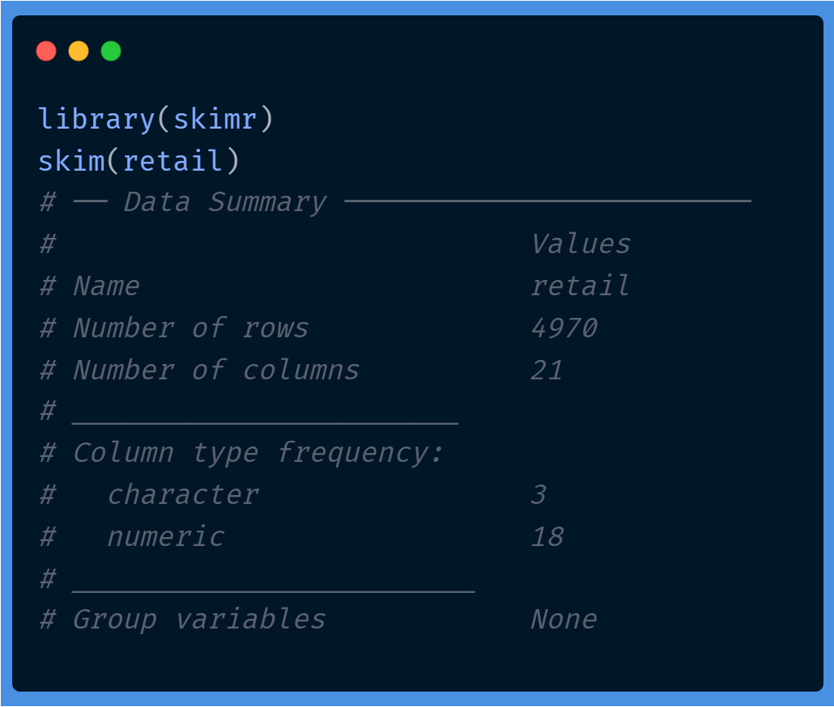
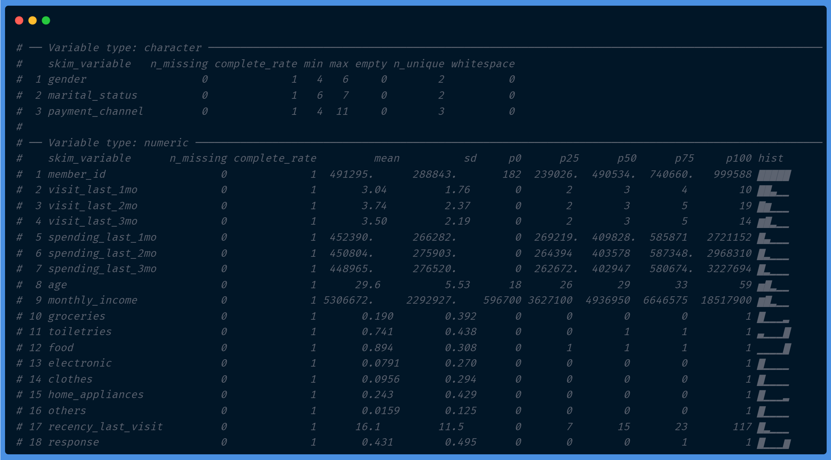

Slide 32
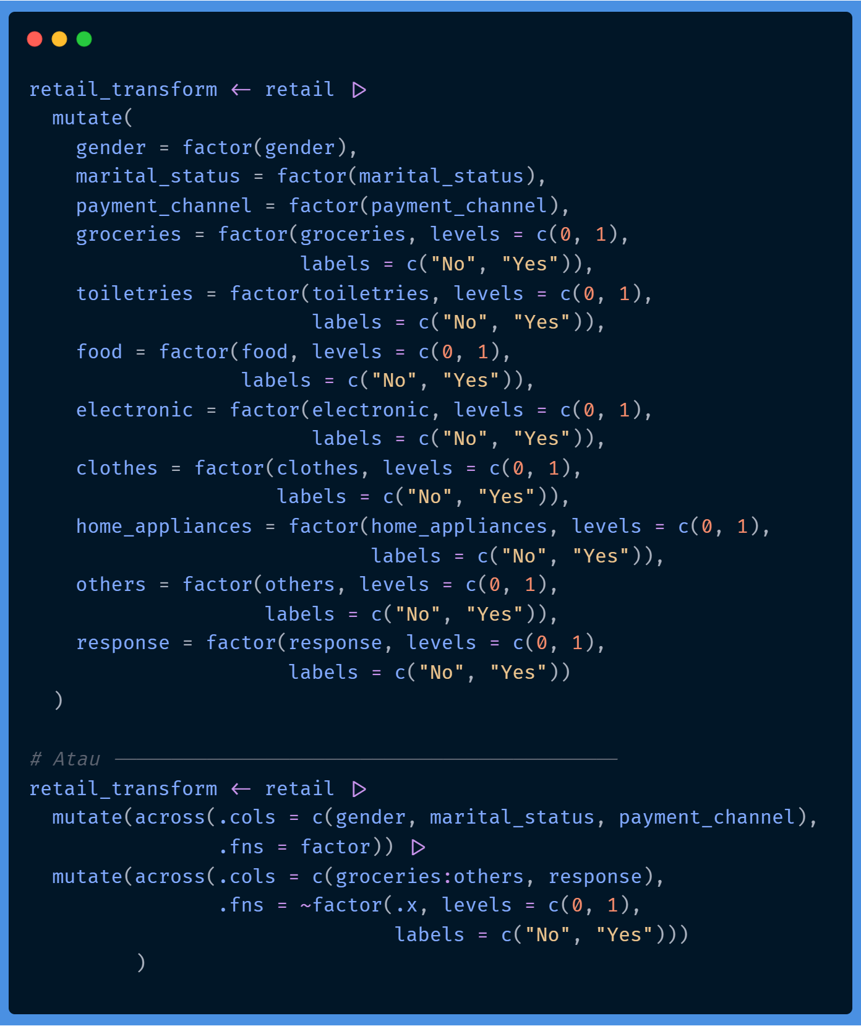
Variable | Type
member_id | ID
gender | Factor/category (binary)
visit_last_1mo | Number
visit_last_2mo | Number
visit_last_3mo | Number
spending_last_1mo | Number
spending_last_2mo | Number
spending_last_3mo | Number
age | Number
monthly_income | Number
marital_status | Factor/category
payment_channel | Factor/category
groceries | Factor/category (binary)
toiletries | Factor/category (binary)
food | Factor/category (binary)
electronic | Factor/category (binary)
clothes | Factor/category (binary)
home_appliances | Factor/category (binary)
others | Factor/category (binary)
recency_last_visit | Number
response | Factor/category (binary target)
Convert Categorical Variable

Slide 33
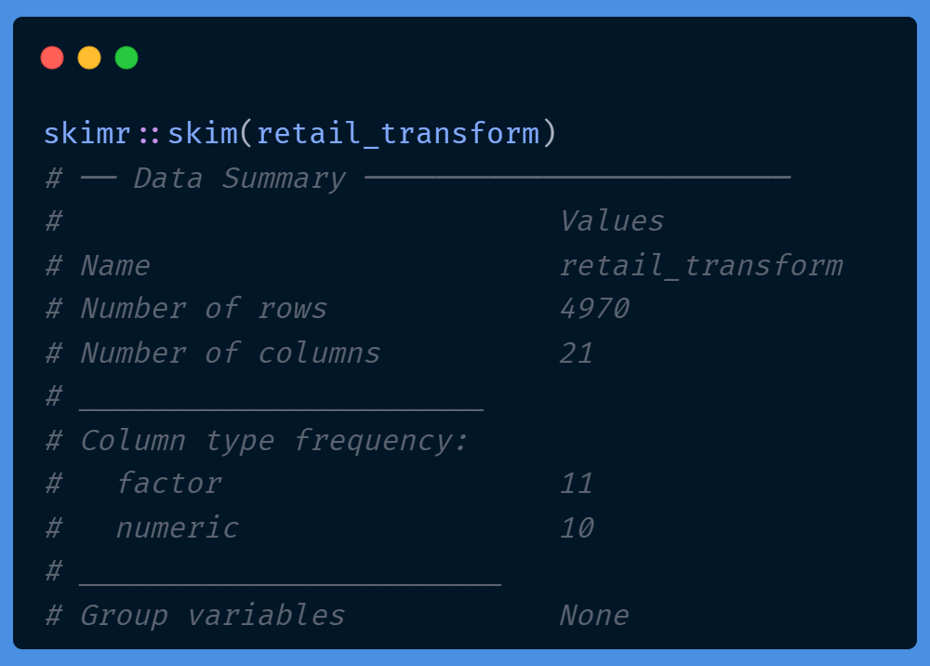
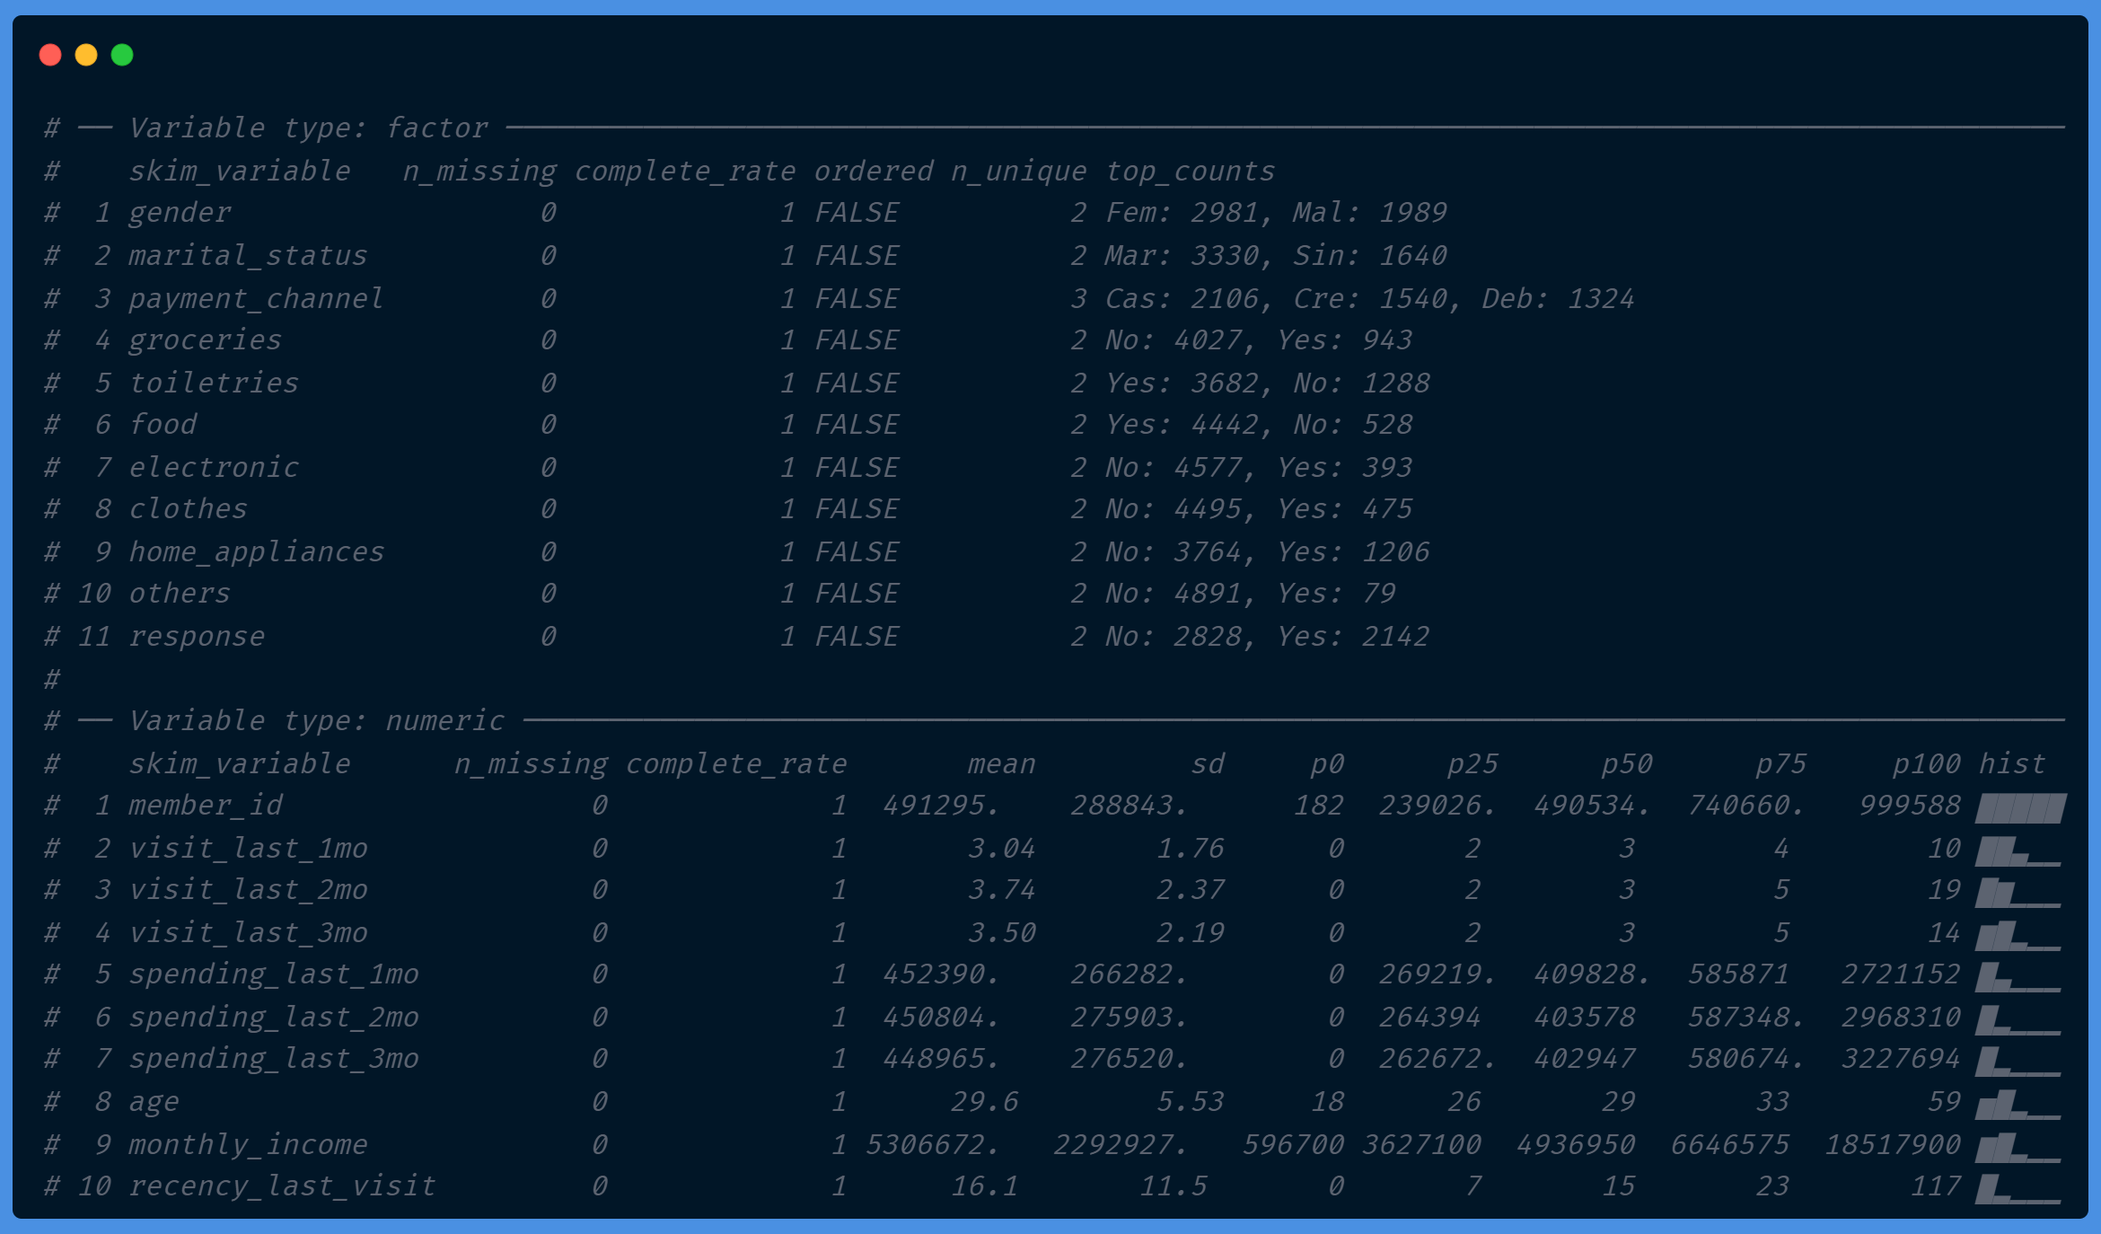

Slide 34
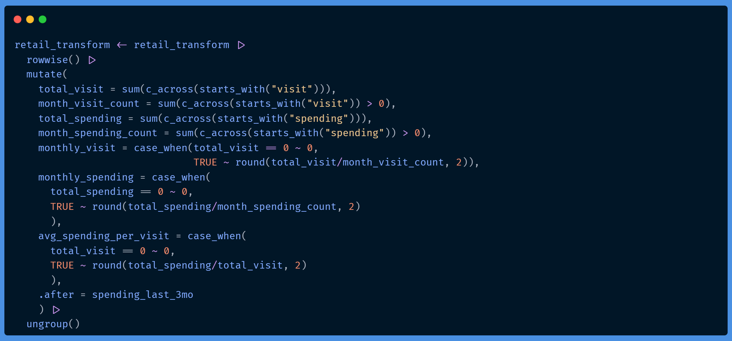
Create New Variables
Variable | Description
total_visit | Sum of all visit variables
month_visit_count | # month with visit > 0
total_spending | Sum of all spending variables
month_spending_count | # month with spending > 0
monthly_visit | Avg monthly visit frequency for P3M
monthly_spending | Avg monthly spending for P3M
avg_spending_per_visit | Avg spending amount per visit

Slide 35
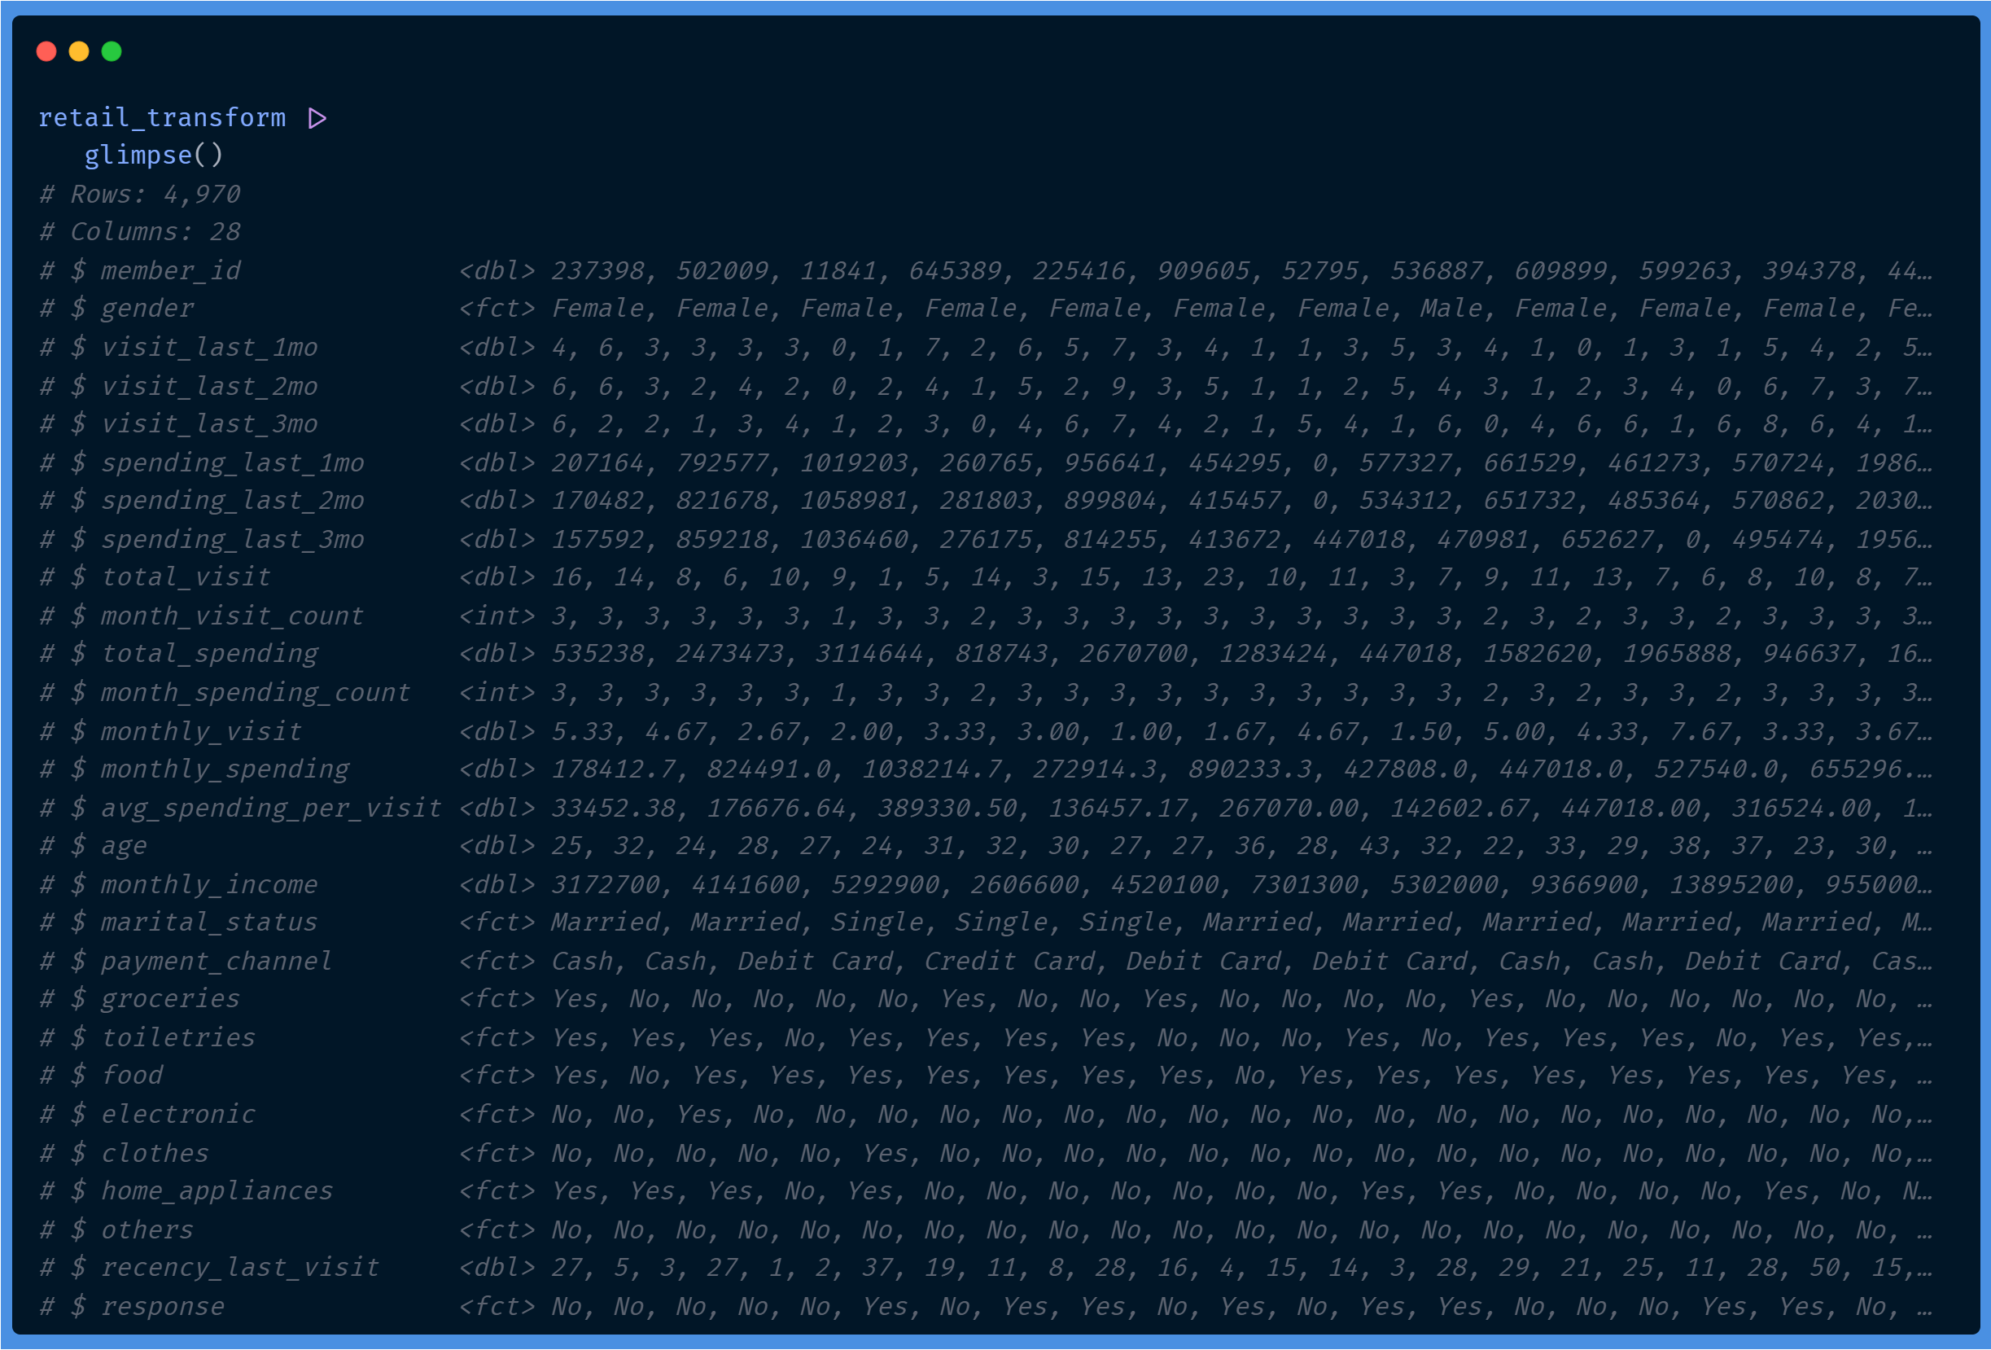

Slide 36

Insight Data Exploration
Knowing the general description of the characteristics of the data to be used.

Slide 37
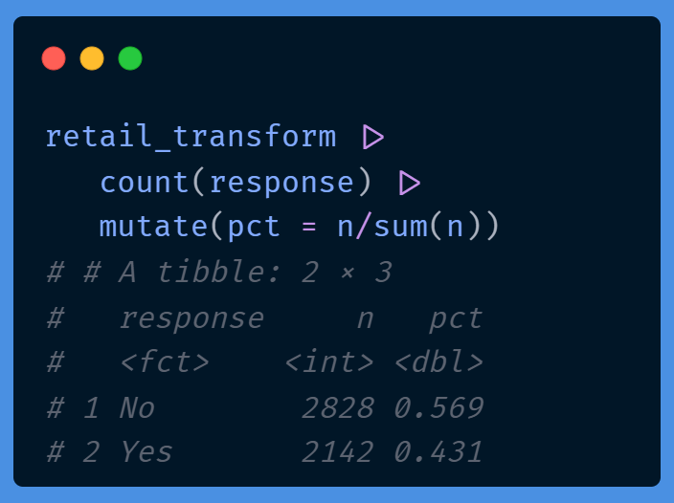
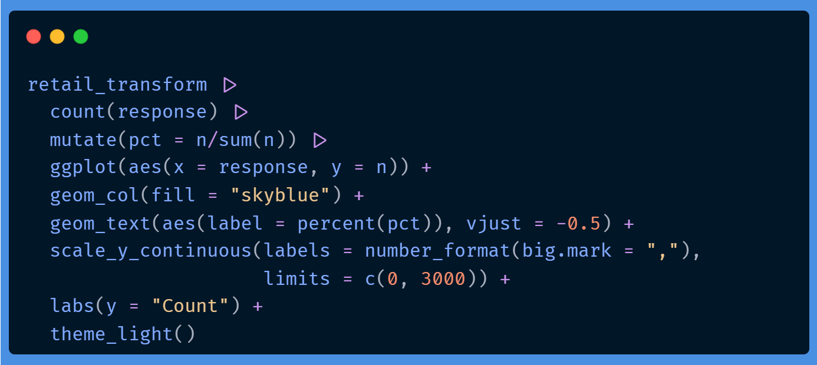
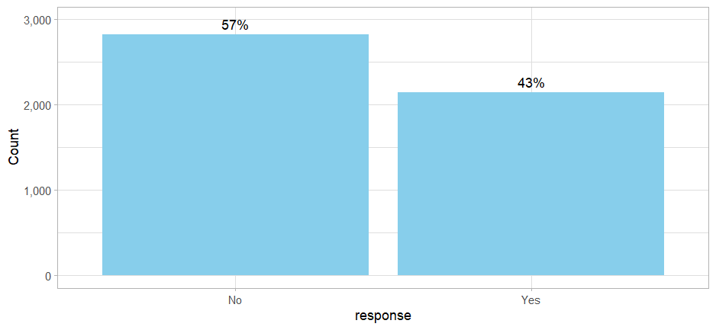
Proportion of Response Category
Balanced!

Slide 38
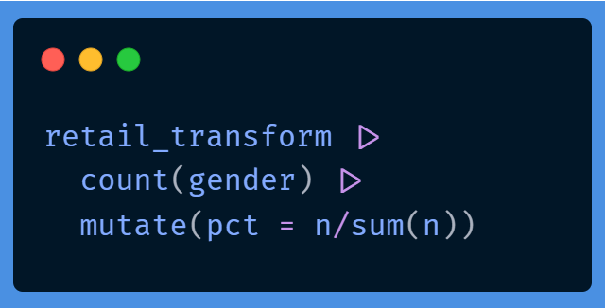
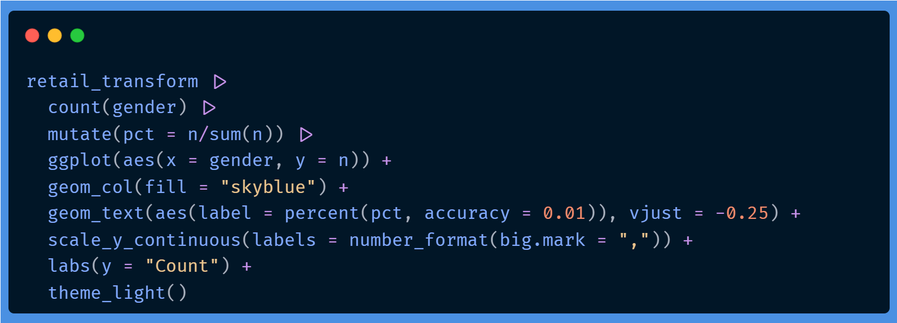
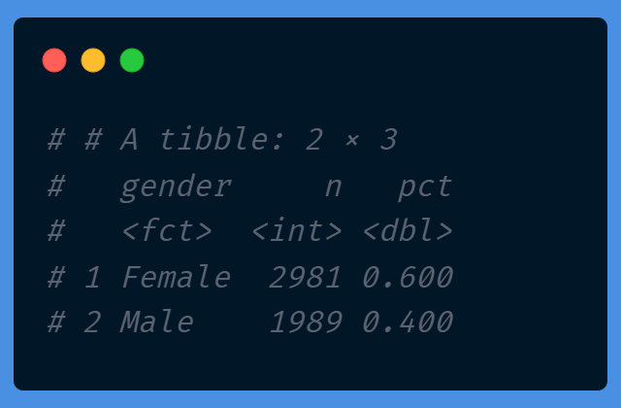
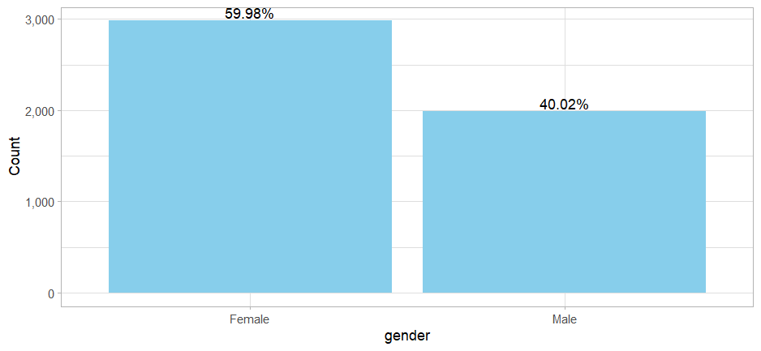
Proportion of Member by Buy Home Appliances
Female are ~1.5x more than Male

Slide 39
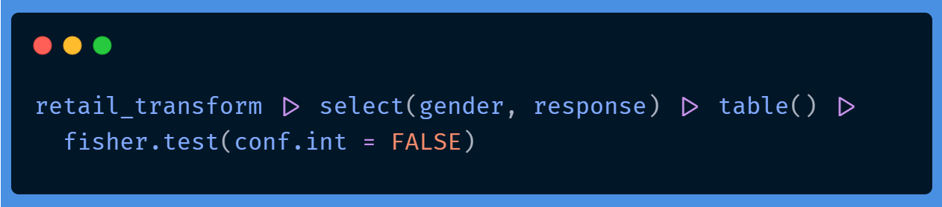
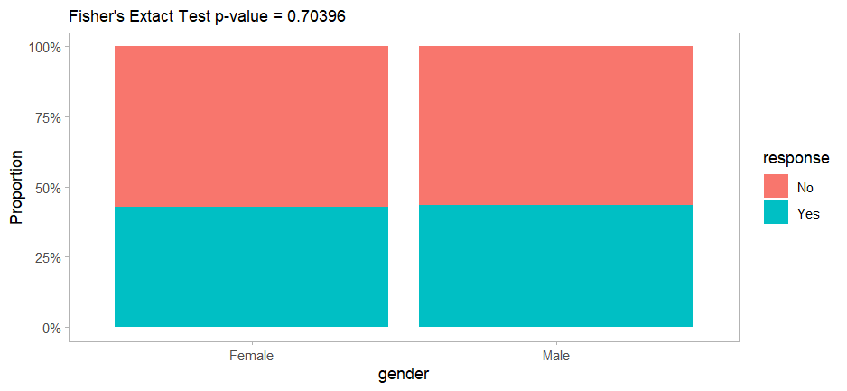
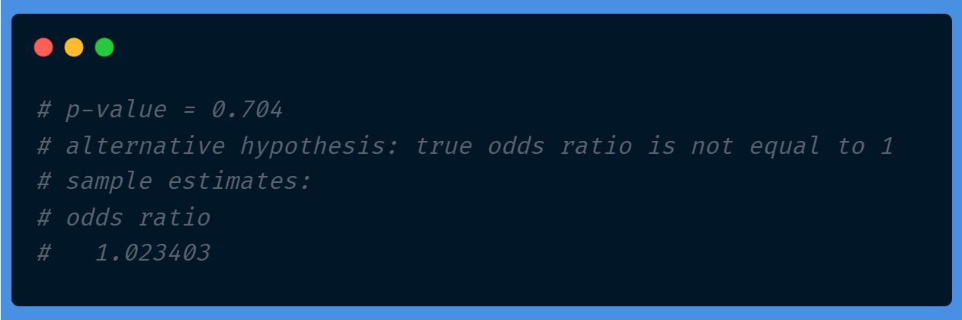
Proportion of Member by Gender Category
Female are ~1.5x more than Male, but not significantly associated with response.
Fisher's Exact Test
H0: Variables are independent (no relationship)
H1: Variables are dependent (there is relationship)
Reject H0 when p-value < alpha

Slide 40
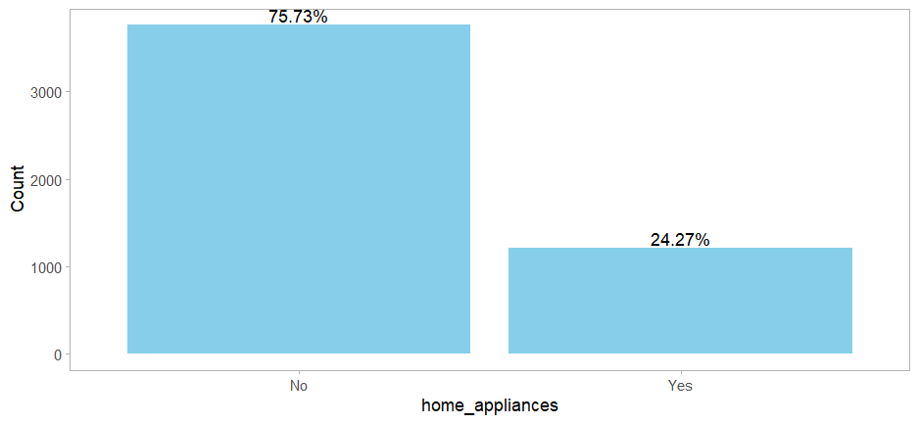
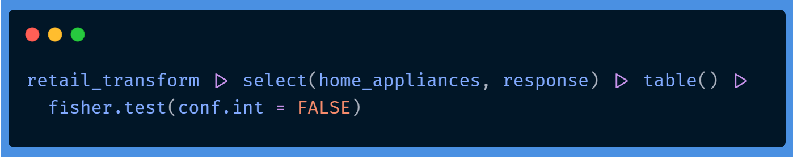
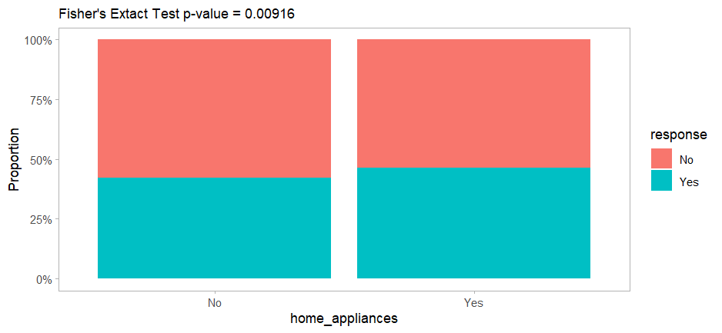
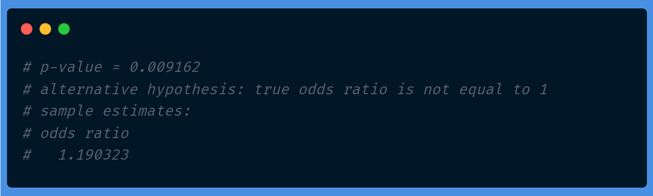
Proportion of Member by Buy Home Appliances
Significantly associated with response.
Fisher's Exact Test
H0: Variables are independent (no relationship)
H1: Variables are dependent (there is relationship)
Reject H0 when p-value < alpha

Slide 41
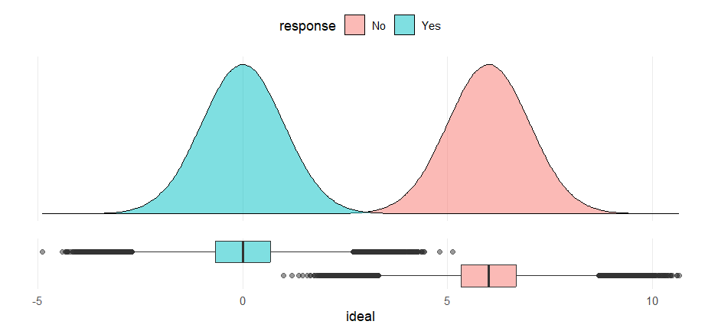
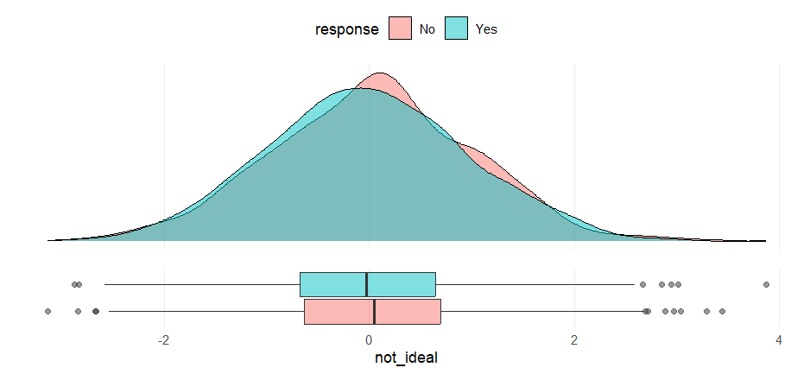
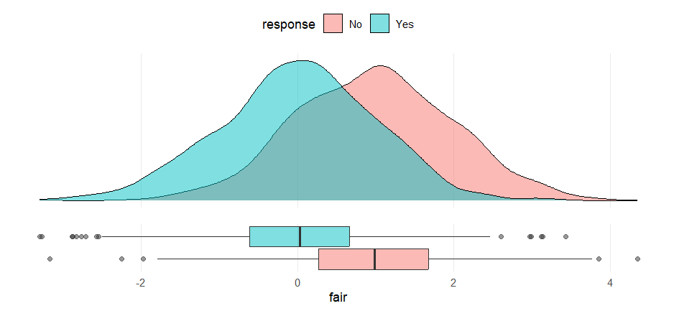
Numeric Variable Distribution by Response
Ideally split with response is significant.

Slide 42
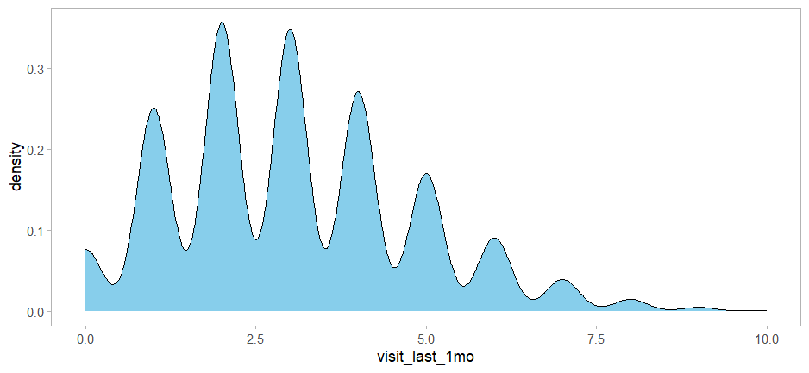
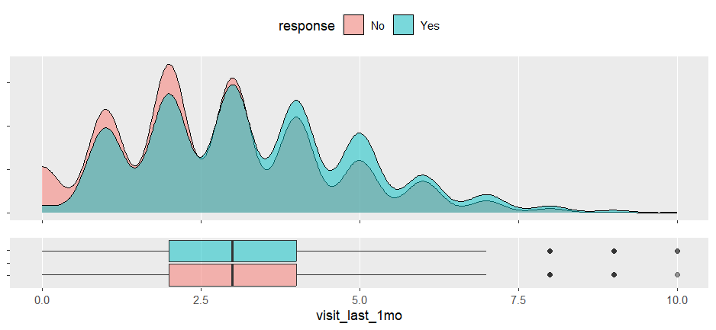
Numeric Variable Distribution by Response
Visit Last 1 Month

Slide 43
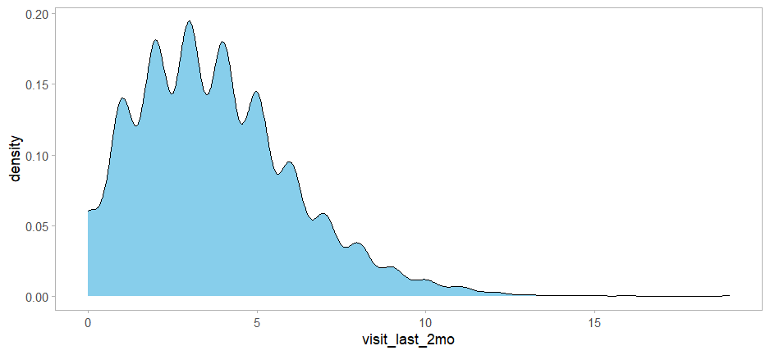
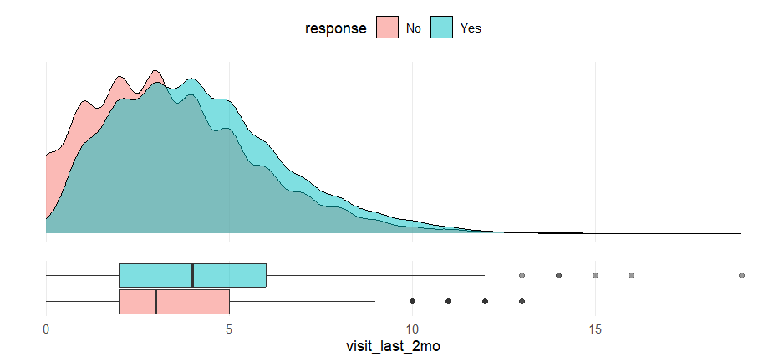
Numeric Variable Distribution by Response
Visit Last 2 Month

Slide 44
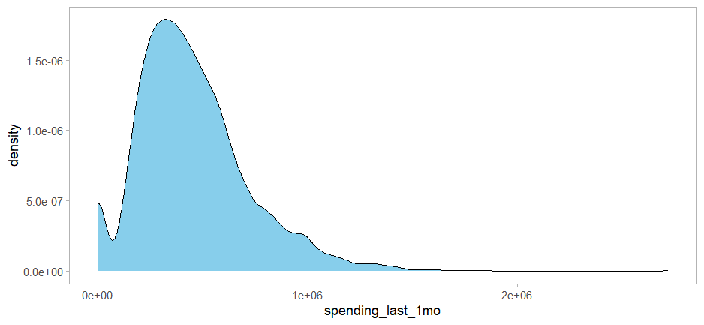
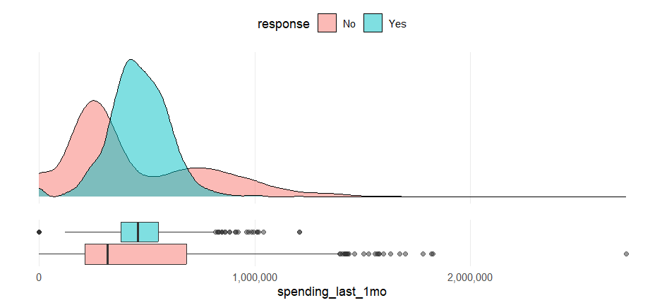
Numeric Variable Distribution by Response
Spending Last 1 Month

Slide 45
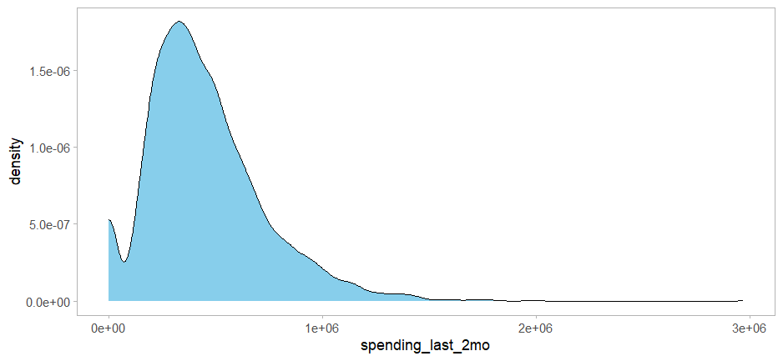
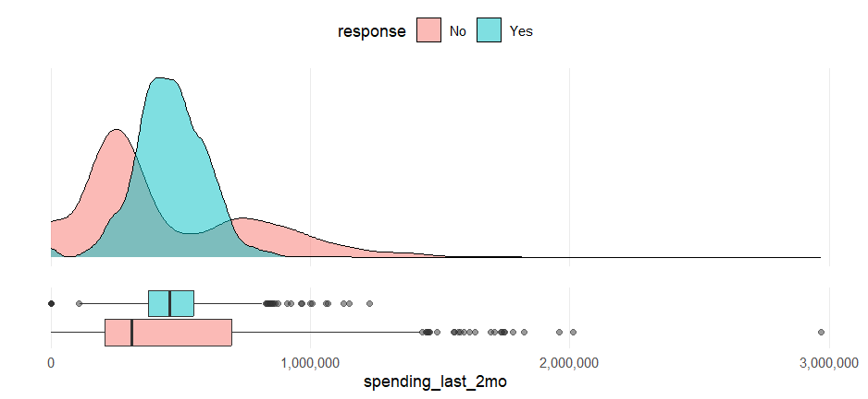
Numeric Variable Distribution by Response
Spending Last 2 Month

Slide 46
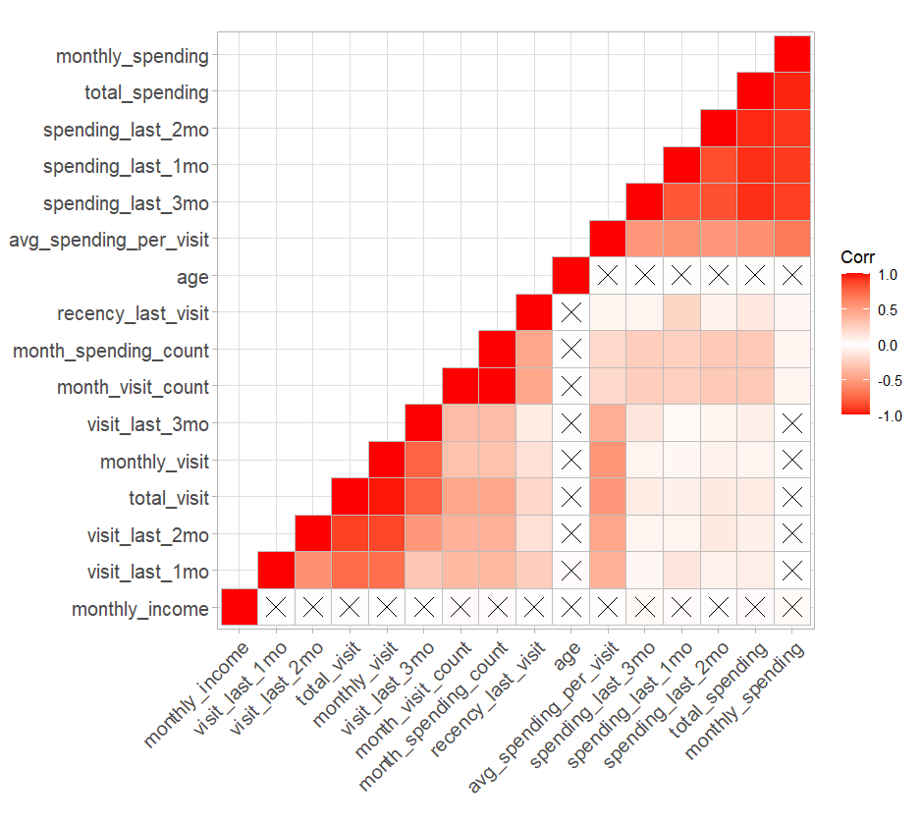
Correlation Numeric Variable
Linear Relationship
X: Insignificant linear relationship

Slide 47
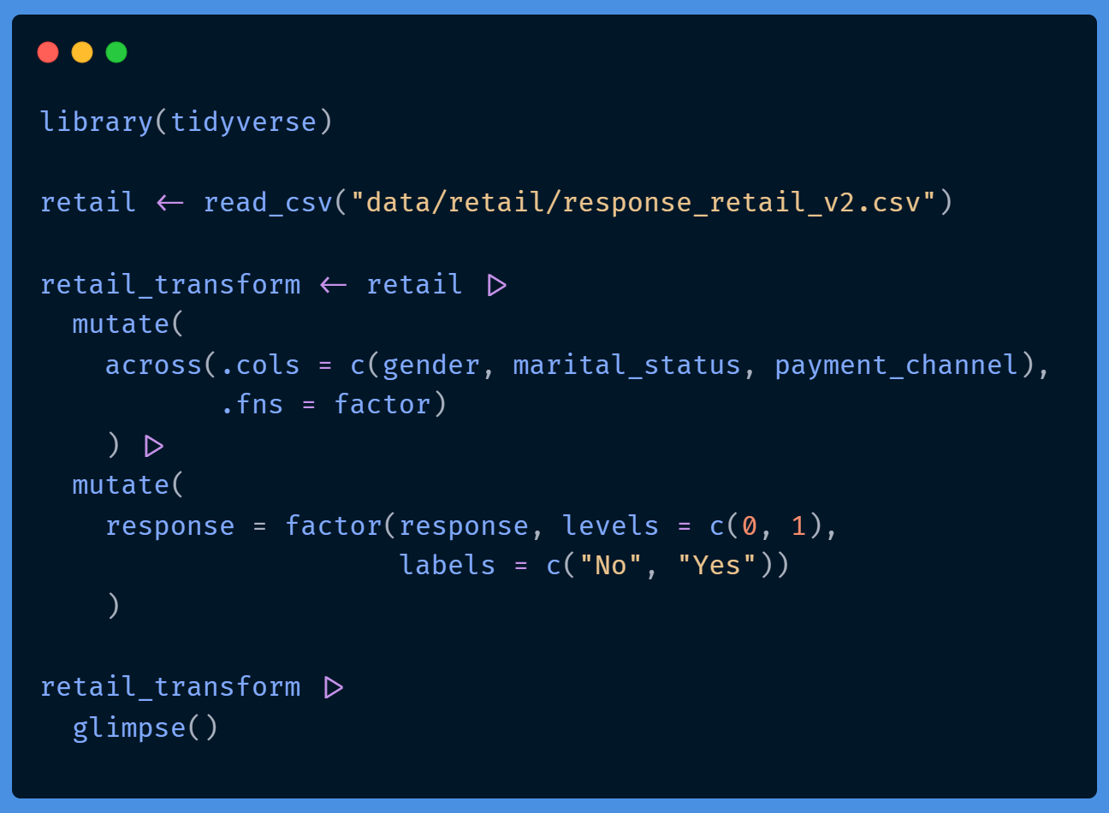
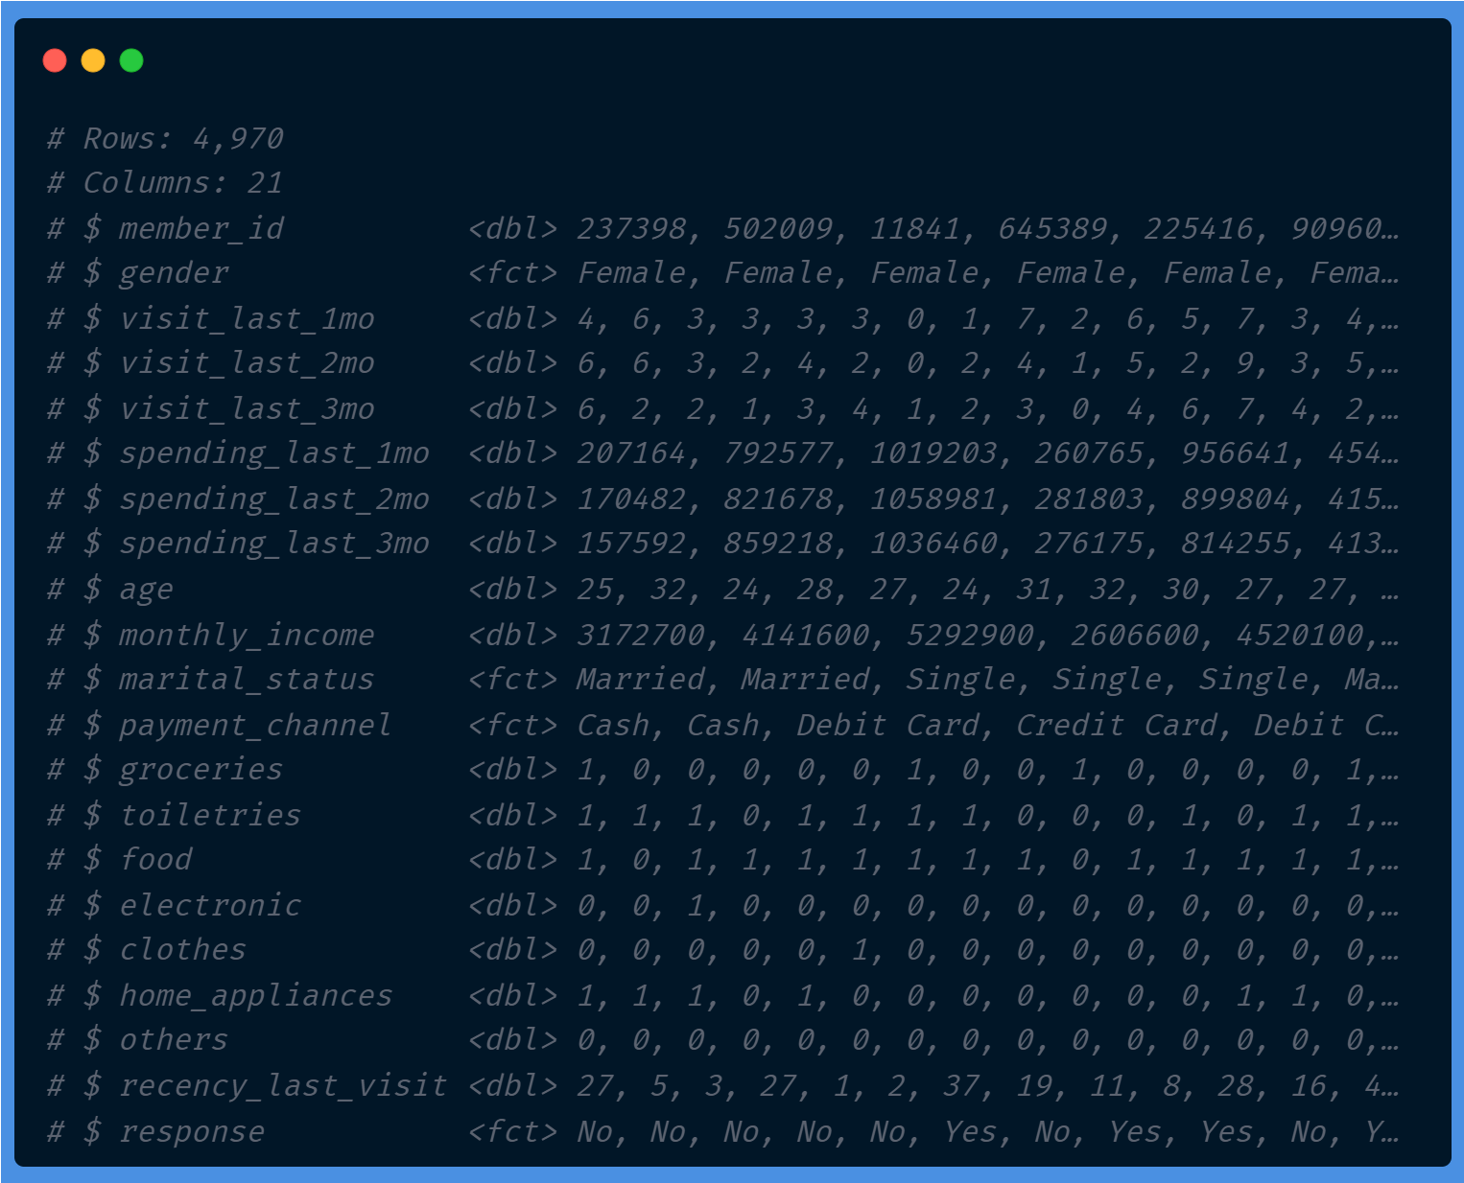
Import Data

Slide 48
Hands-on

Slide 49

Terima kasih!
Anda memiliki pertanyaan?

Slide 50

Aep Hidayatuloh
Sertifikat Partisipasi
Sertifikat ini diberikan kepada
Nama Peserta
atas keikutsertaannya dalam Pelatihan
Introduction to Machine Learning – Learning by Doing
with case study: Retail Propensity-to-Buy.
Aep Hidayatuloh
Tanggal Pelatihan

